Slide 1
Begins July 16

Slide 2
“PRAYING LUTHER’S SMALL CATECHISM”
Prof John T. Pless
Lesson 4
Date: 8-6-17
Trinity Lutheran Church Norman, OK
Pastor David Nehrenz
Catechesis =
Teaching with questions and answers
Bible Study: The Lord’s Prayer

Slide 4
Scripture Texts:
Matthew 6:5-15; 26:36-46;
Luke 11:1-13; 22:40-46;
1 Tim 2:1-6;
1 Thess 5:17

Slide 5
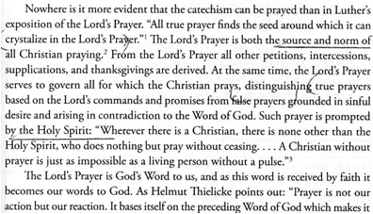

Slide 6
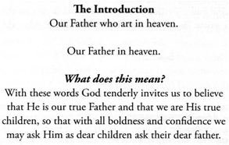
.

Slide 8
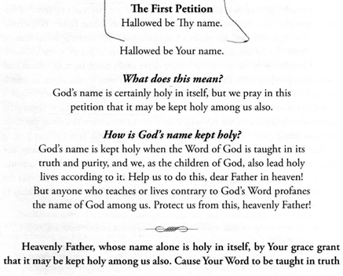

Slide 9
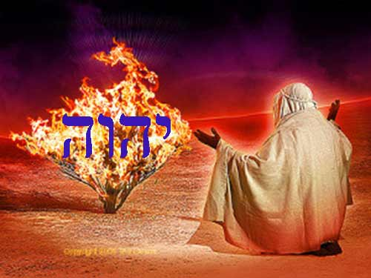

Slide 10
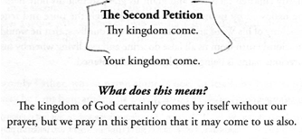
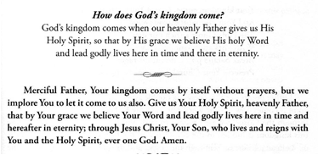

Slide 12
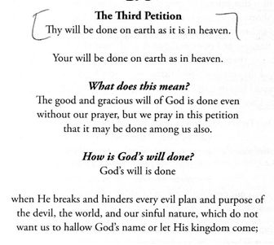
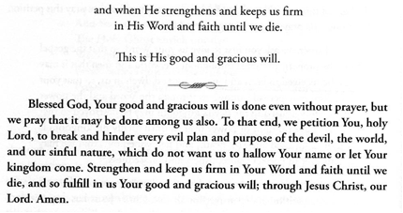

Slide 14
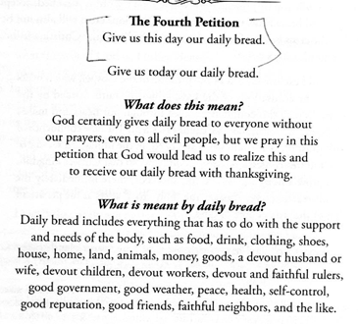

Slide 16
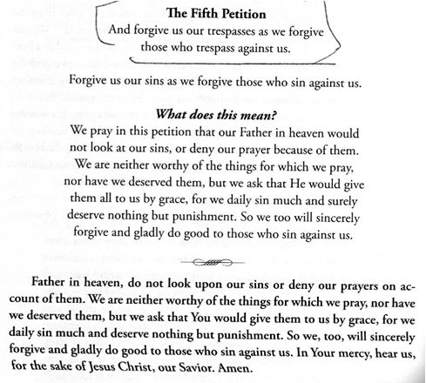

Slide 17
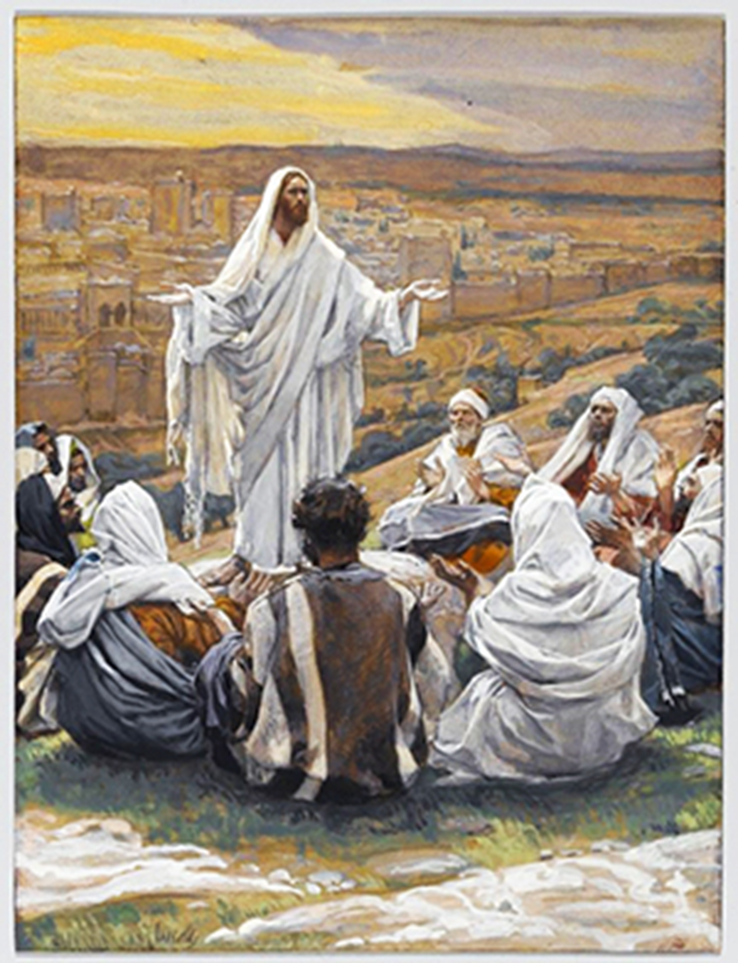

Slide 18
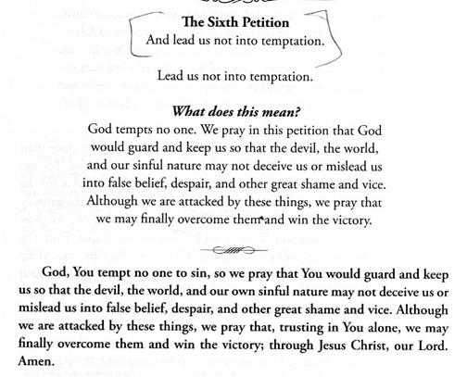

Slide 20
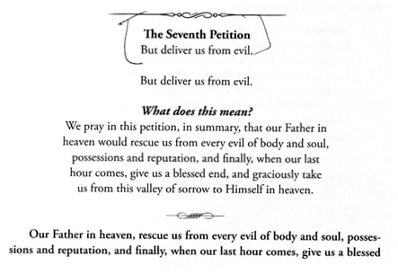

Slide 22
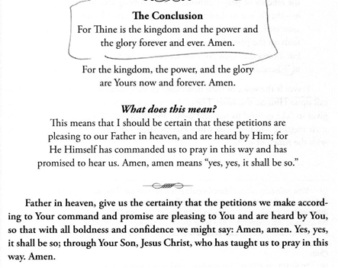

Slide 24
