Slide 1
“HERE WE STAND” LIFE SUNDAY 1-22-17 Combined Bible Class – All Teens and Adults Schedule for the day: Combined Bible Class – All Teens and Adults Schedule for the day: 9:15 a.m. - Foundational Truths from God’s Word 9:50 a.m. - Video “Lutherans for Life” 10:15 a.m. - Closing Prayer

Slide 10
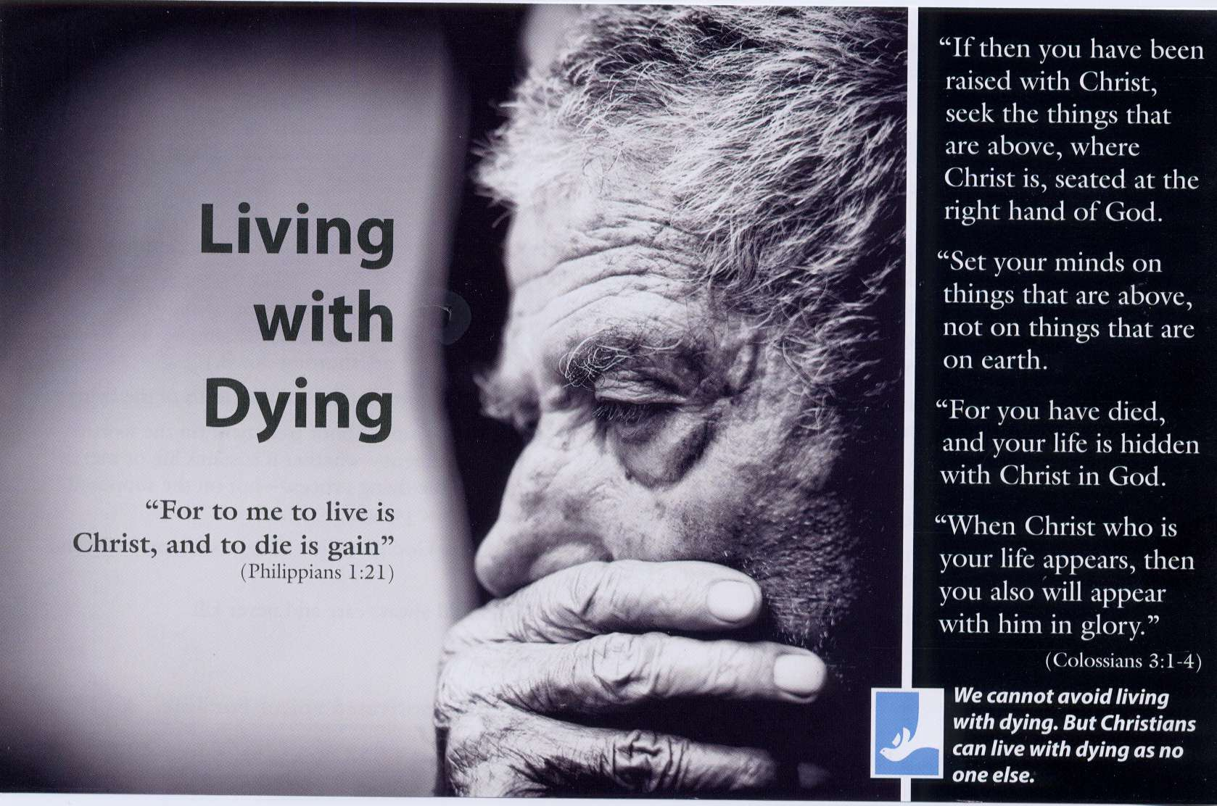

Slide 11
“When the going gets tough, the tough get going.” With its emphasis on armor and wrestling, flaming darts, forces of the devil, and evil schemes, it may seem these slogans summarize the message of St. Paul’s pep talk to the Ephesian Christians. Then again, Ephesians 6:10-18 speaks the Word of the Lord rather than simply restating the world’s wisdom. So we might suspect a different strength and a better strategy…

Slide 13
Ephesians 6:12 – What makes life a wrestling match?
James 4:1 –
Romans 7:19-23 –
Galatians 5:17 –
Ephesians 6:12 – Who (or what?) are the real enemies (and who are not)?
Romans 5:10 –
Romans 8:7 –
1 Peter 5:8 –
2 Thessalonians 3:14-15 –

Slide 16
Here We Stand against sin and selfishness, death and the devil, not against one another.
Ephesians 6:11, 13 – Who needs armor and why?
Ezekiel 18:32 –
1 Timothy 2:3-4 –
Matthew 18:14 –
Isaiah 46:4 –
Luke 7:22
Romans 3:23 ––

Slide 18
Here We Stand to declare and defend the precious value of every human being.
Here We Stand for every human life, at each stage, in any state.
Here We Stand for every human life, no matter what she’s done, no matter what he can’t do.
Here We Stand from the invisible miracle of conception to the moment of natural death.
Here We Stand for anyone vulnerable or victim to violence against life.
Here We Stand for you, wherever you’ve been, wherever you’re going.
Ephesians 6:14-17 – What kind of armor do we possess? Where does it come from?
Revelation 7:10 –
Philippians 3:9 –
Philippians 1:6 –

Slide 19
Here We Stand because of God’s purpose, not our own plans.
Here We Stand behind Jesus Christ’s passion, not our own pride.
Here We Stand bearing His Holy Spirit’s presence, not our own capacities.
Which victory matters most?
John 16:33 –
1 Corinthians 15:56-57 –
Luke 10:20 –
Here We Stand for forgiveness and not comparison, for salvation and not competition.
Ephesians 6:18 – Who accompanies us in the conflict?
Hebrews 12:1, 22-24 –
1 Corinthians 12:26 –
Hebrews 2:14-18 –

Slide 20
Here We Stand with millions of His children around the world and multitudes across the centuries.
Here We Stand with you, wherever you are.
Ephesians 6:10 – What motivates us in the middle of it?
John 10:10 –
1 John 4:10 –
2 Corinthians 3:12 –
Here We Stand to celebrate the many blessings of abundant and everlasting life.
Here We Stand in joy and not out of anger, in hope and not out of fear.
Here We Stand as Gospel-motivated voices For Life.
Ephesians 6:13 – Why are we instructed to stand instead of advance?
Exodus 14:13-14 –
Deuteronomy 28:13-14 –
Hebrews 12:26-28 –

Slide 21
Here We Stand.
How then shall we struggle, wrestle, and battle?
Ephesians 4:15 –
1 Peter 3:15 –
Ephesians 4:32 –
Galatians 6:2 –
Here We Stand to relieve and release, not to accuse.
Here We Stand to listen, assist, accompany, embrace, and befriend—not to attack.
Here We Stand speaking truth and sharing love.

Slide 22
NOTE:
2017 IS THE 500TH ANNIVERSARY OF MARTIN LUTHER POSTING THE 95 THESES ON OCT. 31, 1517. LUTHER IS THE ONE WHO SAID BEFORE THE EMPEROR, ‘HERE I STAND (ON THE WORD OF GOD)
I CAN DO NO OTHER, SO HELP ME GOD!”
THUS WE ALSO SAY “HERE WE STAND!”
“Life Issues” cover the whole range of respect for life, from conception in the womb until old age. Thus we honor God’s gift of life and oppose all attacks upon it by the devil, the world and our own sinful self!
“Life Issues” therefore means that we:
SPEAK AGAINST: Abortion but STAND UP for Adoption
SPEAK AGAINST: Infanticide but STAND UP for Mercy for the Disabled
SPEAK AGAINST: Suicide but STAND UP for Godly Self-Identity
SPEAK AGAINST: Genocide but STAND UP for All God’s Children
SPEAK AGAINST: Euthanasia but STAND UP for Dignity for the Elderly
Lutherans For Life • www.lutheransforlife.org 888.364.LIFE

Slide 27
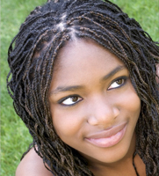

Slide 29
“SAVE THE CHILDREN” Listen to the gentle heartbeat, Of the little baby in the womb. Will this child be allowed to live? Or will the womb become a tomb? CHORUS: Save the children Who though unborn are living. Don’t take their lives. Save the children Who though unborn are living. Don’t take their lives. This most defenseless human being. Lives nine months before he is born. Some people don’t want him around, If he dies, none of them will mourn. What is your answer my friend? Can we allow this to go on? With such a means, what is the end? I hope you see that it is wrong.

Slide 30
(Written by David Nehrenz in 1979, while he was a 2nd year seminarian at Concordia Theological Seminary Ft. Wayne, Indiana. This song was sung in January 1979 on the steps of the United States Capitol Building in Washington D.C. The occasion was the annual “March for Life” organized at the time by Nellie Gray. My friends and fellow seminarians Marty Kaarre, David Weber and I were members of a Christian band called “Tarkkuus” (the Finnish word for “truth”). We marched at the head of the line with over 50,000 people down the streets heading to the Capitol building. In the 10 degree weather, we took off our gloves, pulled out our guitars and sang this song over the P.A. system, before the United States Congressmen and Senators spoke. To hear these 50,000 people join us in singing this chorus of “Save the Children” was inspiring. The people in the Pro-Life Movement are some of the finest people I have ever met. They are filled with mercy, kindness and love because they are helping other people save their own children.)

Slide 31
Ps 139: 23,24 – Closing Prayer
“Search me, O God, and know my heart!
Try me and know my thoughts!
And see if there be
any grievous way in me,
and lead me in the way everlasting! Amen.”

