Slide 1
A BIBLE STUDY OF THE BOOK OF ECCLESIASTES
Theme:
Solomon and Jesus,
Both Sons of David, say:
“Fear God and keep his commandments,
For this is the whole duty of man!”
Trinity Lutheran Church
Norman, Oklahoma
Pastor David Nehrenz
Date: 9-20-15
Lesson: 3

Slide 2
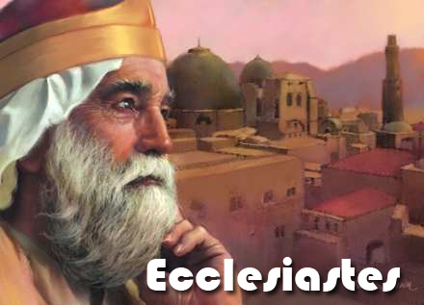

Slide 4
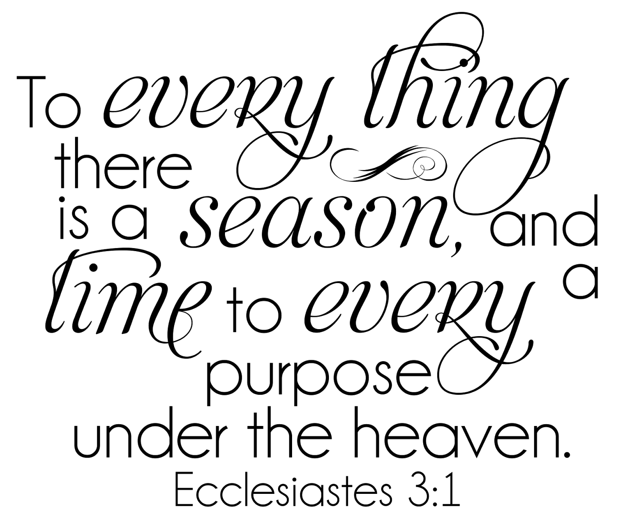

Slide 5
(Chapter 3) (1) For everything there is a season, and a time for every matter under heaven: (2) a time to be born, and a time to die; a time to plant, and a time to pluck up what is planted; (3) a time to kill, and a time to heal; a time to break down, and a time to build up; (4) a time to weep, and a time to laugh; a time to mourn, and a time to dance; (5) a time to cast away stones, and a time to gather stones together; a time to embrace, and a time to refrain from embracing; (6) a time to seek, and a time to lose; a time to keep, and a time to cast away; (7) a time to tear, and a time to sew; a time to keep silence, and a time to speak; (8) a time to love, and a time to hate; a time for war, and a time for peace.

Slide 6
(9) What gain has the worker from his toil? (10) I have seen the business that God has given to the children of man to be busy with. (11) He has made everything beautiful in its time. Also, he has put eternity into man's heart, yet so that he cannot find out what God has done from the beginning to the end. (12) I perceived that there is nothing better for them than to be joyful and to do good as long as they live; (13) also that everyone should eat and drink and take pleasure in all his toil--this is God's gift to man. (14) I perceived that whatever God does endures forever; nothing can be added to it, nor anything taken from it. God has done it, so that people fear before him. (15) That which is, already has been; that which is to be, already has been; and God seeks what has been driven away.

Slide 7
(16) Moreover, I saw under the sun that in the place of justice, even there was wickedness, and in the place of righteousness, even there was wickedness. (17) I said in my heart, God will judge the righteous and the wicked, for there is a time for every matter and for every work.
(18) I said in my heart with regard to the children of man that God is testing them that they may see that they themselves are but beasts. (19) For what happens to the children of man and what happens to the beasts is the same; as one dies, so dies the other. They all have the same breath, and man has no advantage over the beasts, for all is vanity. (20) All go to one place. All are from the dust, and to dust all return. (21) Who knows whether the spirit of man goes upward and the spirit of the beast goes down into the earth?
(22) So I saw that there is nothing better than that a man should rejoice in his work, for that is his lot. Who can bring him to see what will be after him?

Slide 8
B. STUDY NOTES 1. During our time on earth, our lives are subject to changes and fluctuations over which we have no control. God however has everything under his sovereignty and all of the activities on earth are under his control. The concept of “a time” = divinely appointed events (Ps 31:15; Prov 16:1-9; Rom 13:4) 2. The world is a beautiful place but God has put in our hearts a desire for the better world of heaven. We have a foretaste of the new heavens and earth, we are made for eternity and this temporal life will never truly satisfy us. (Rom 2:15; 11:33; 12:15; Heb 9:27) 3.Vv. 12-13 points to the end of the book where the conclusion is that we accept all things from God’s hand cheerfully, both in good times and bad. (Php 4:11-13)

Slide 9
4. The eternal plans of God are forever and never end. (James 1:17) 5. Ultimately – on Judgment Day - God will settle all accounts. We can become cynical when we see everywhere the injustices of man which go unpunished. It is perverse to see how people are able to carry out all manner of evil and horror upon others. In the end, no one will escape God’s righteous judgement. (Job 19:29; Matt 16:27; 26:57-68; 2 Cor 5:10; Rom 2:6-11; 2 Th 1:6-10) 6. Man and beast have the same breath of life in them (Ps 104:27-30)

Slide 10
7. From the perspective of a life without God, man and beast both die the same way and return to dust. This is what we observe with our eyes. (Gen 3:19; Ps 103:14) With the eyes of faith, opened by God’s Word, we know that God gives to his believing children the immortality of the soul and the resurrection of the body. (1 Cor 15:20-26; 51-58) 8. Without the insight of God’s Word – who knows what happens after we die? But gradually we get glimpses of an answer to this question: (Ps 16:9-11; 49:15; 73:23-26; Job 14:21; Is 26:19; Dan 12:2-3; Rom 8:18; 2 Tim 1:10) 9. Nothing is better than to receive everything as a gift of God, which gives it all enduring worth.

Slide 11
NOTE: The liturgy on Sunday is called “Gottes-dienst” = God’s divine service of us. What happens at the divine service is that God serves us with forgiveness of sins, life and salvation through preaching, teaching, baptizing, absolving and communing. Then we respond in faith with worship through prayers, praise and thanksgiving to Him.

Slide 12
Luther’s Works AE 15:49: “All human works and efforts have a certain and definite time of acting, of beginning, and of ending, beyond human control. Thus this is spoken in opposition to free will. It is not up to us to prescribe the time, the manner, or the effect of the things that are to be done; and so it is obvious that here our strivings and efforts are unreliable. Everything comes and goes at the time that God has appointed. He proves this on the basis of examples of human works whose times lie outside the choice of man.
From this he draws the conclusion that it is useless for men to be tormented by their strivings and that they do not accomplish anything, even though they were to burst, unless the proper time and the hour appointed by God has come. Here the statement in the Gospel is pertinent (John 7:30): “His hour had not yet come”; and again (John 16:21): “When a woman is in travail, she has sorrow, because her hour has come.” So the power of God comprehends all things in definite hours, so that they cannot be hindered by anyone.”
Luther, M. (1999). Luther’s works, vol. 15: Ecclesiastes, Song of Solomon, Last Words of David, 2 Samuel 23:1-7. (J. J. Pelikan, H. C. Oswald, & H. T. Lehmann, Eds.) (Vol. 15, p. 49). Saint Louis: Concordia Publishing House.

Slide 13
C. LIFE APPLICATION
How do we deal with life that constantly shifts between “times” that are good/evil, prosperity/failure, living/dying, health/sickness, joy/despair?
2. Why will we be able to trust the providential hand of God our Father through His Son Jesus Christ in the power of the Holy Spirit, even when our eyes cannot see how He is working out everything for our eternal good?

Slide 14
