Slide 1
“God’s Treasured Possession!”
-The Book of Deuteronomy-
Old Israel and New Israel =
The Church
Lesson 6 for us:
“You shall love the Lord your God
with all your heart and with all your soul and with all your might”
Date: 11-20-16
Study: #6
Text: Chapter 5:1-25

Slide 2
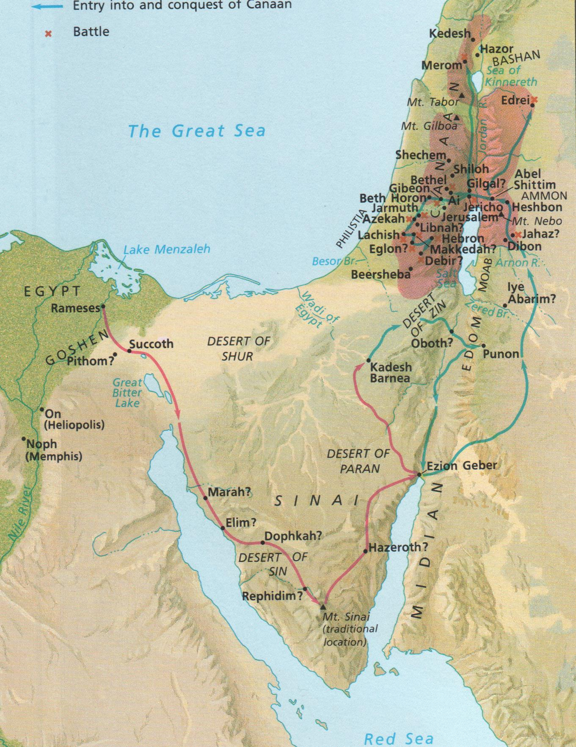

Slide 6
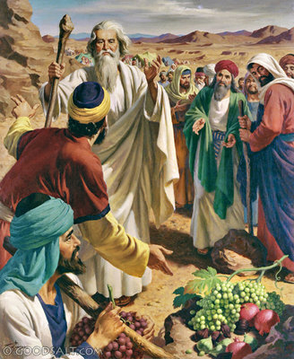

Slide 7
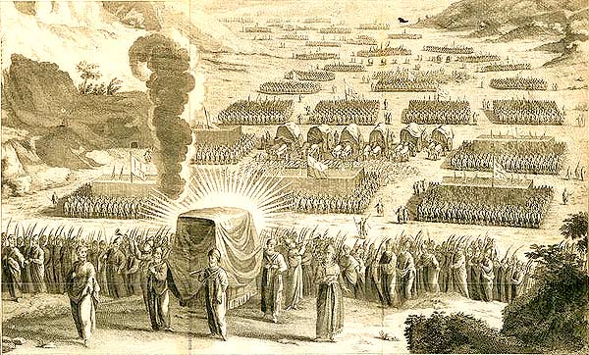

Slide 8
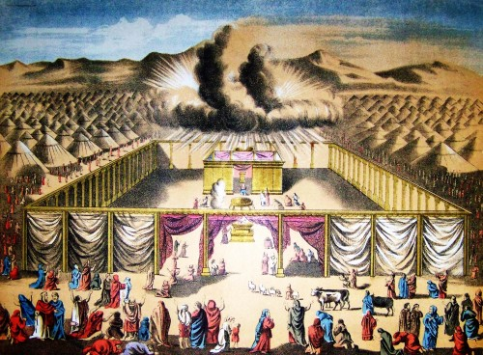

Slide 9
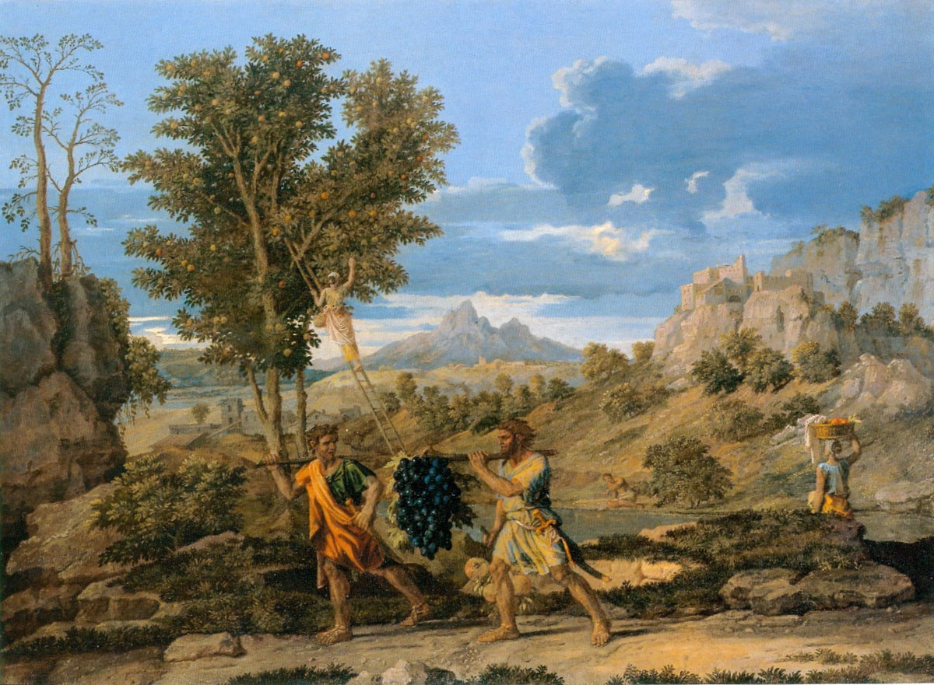

Slide 10
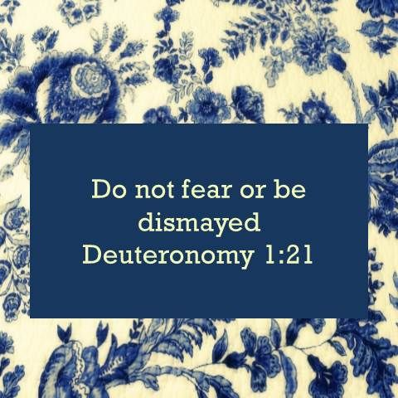

Slide 16
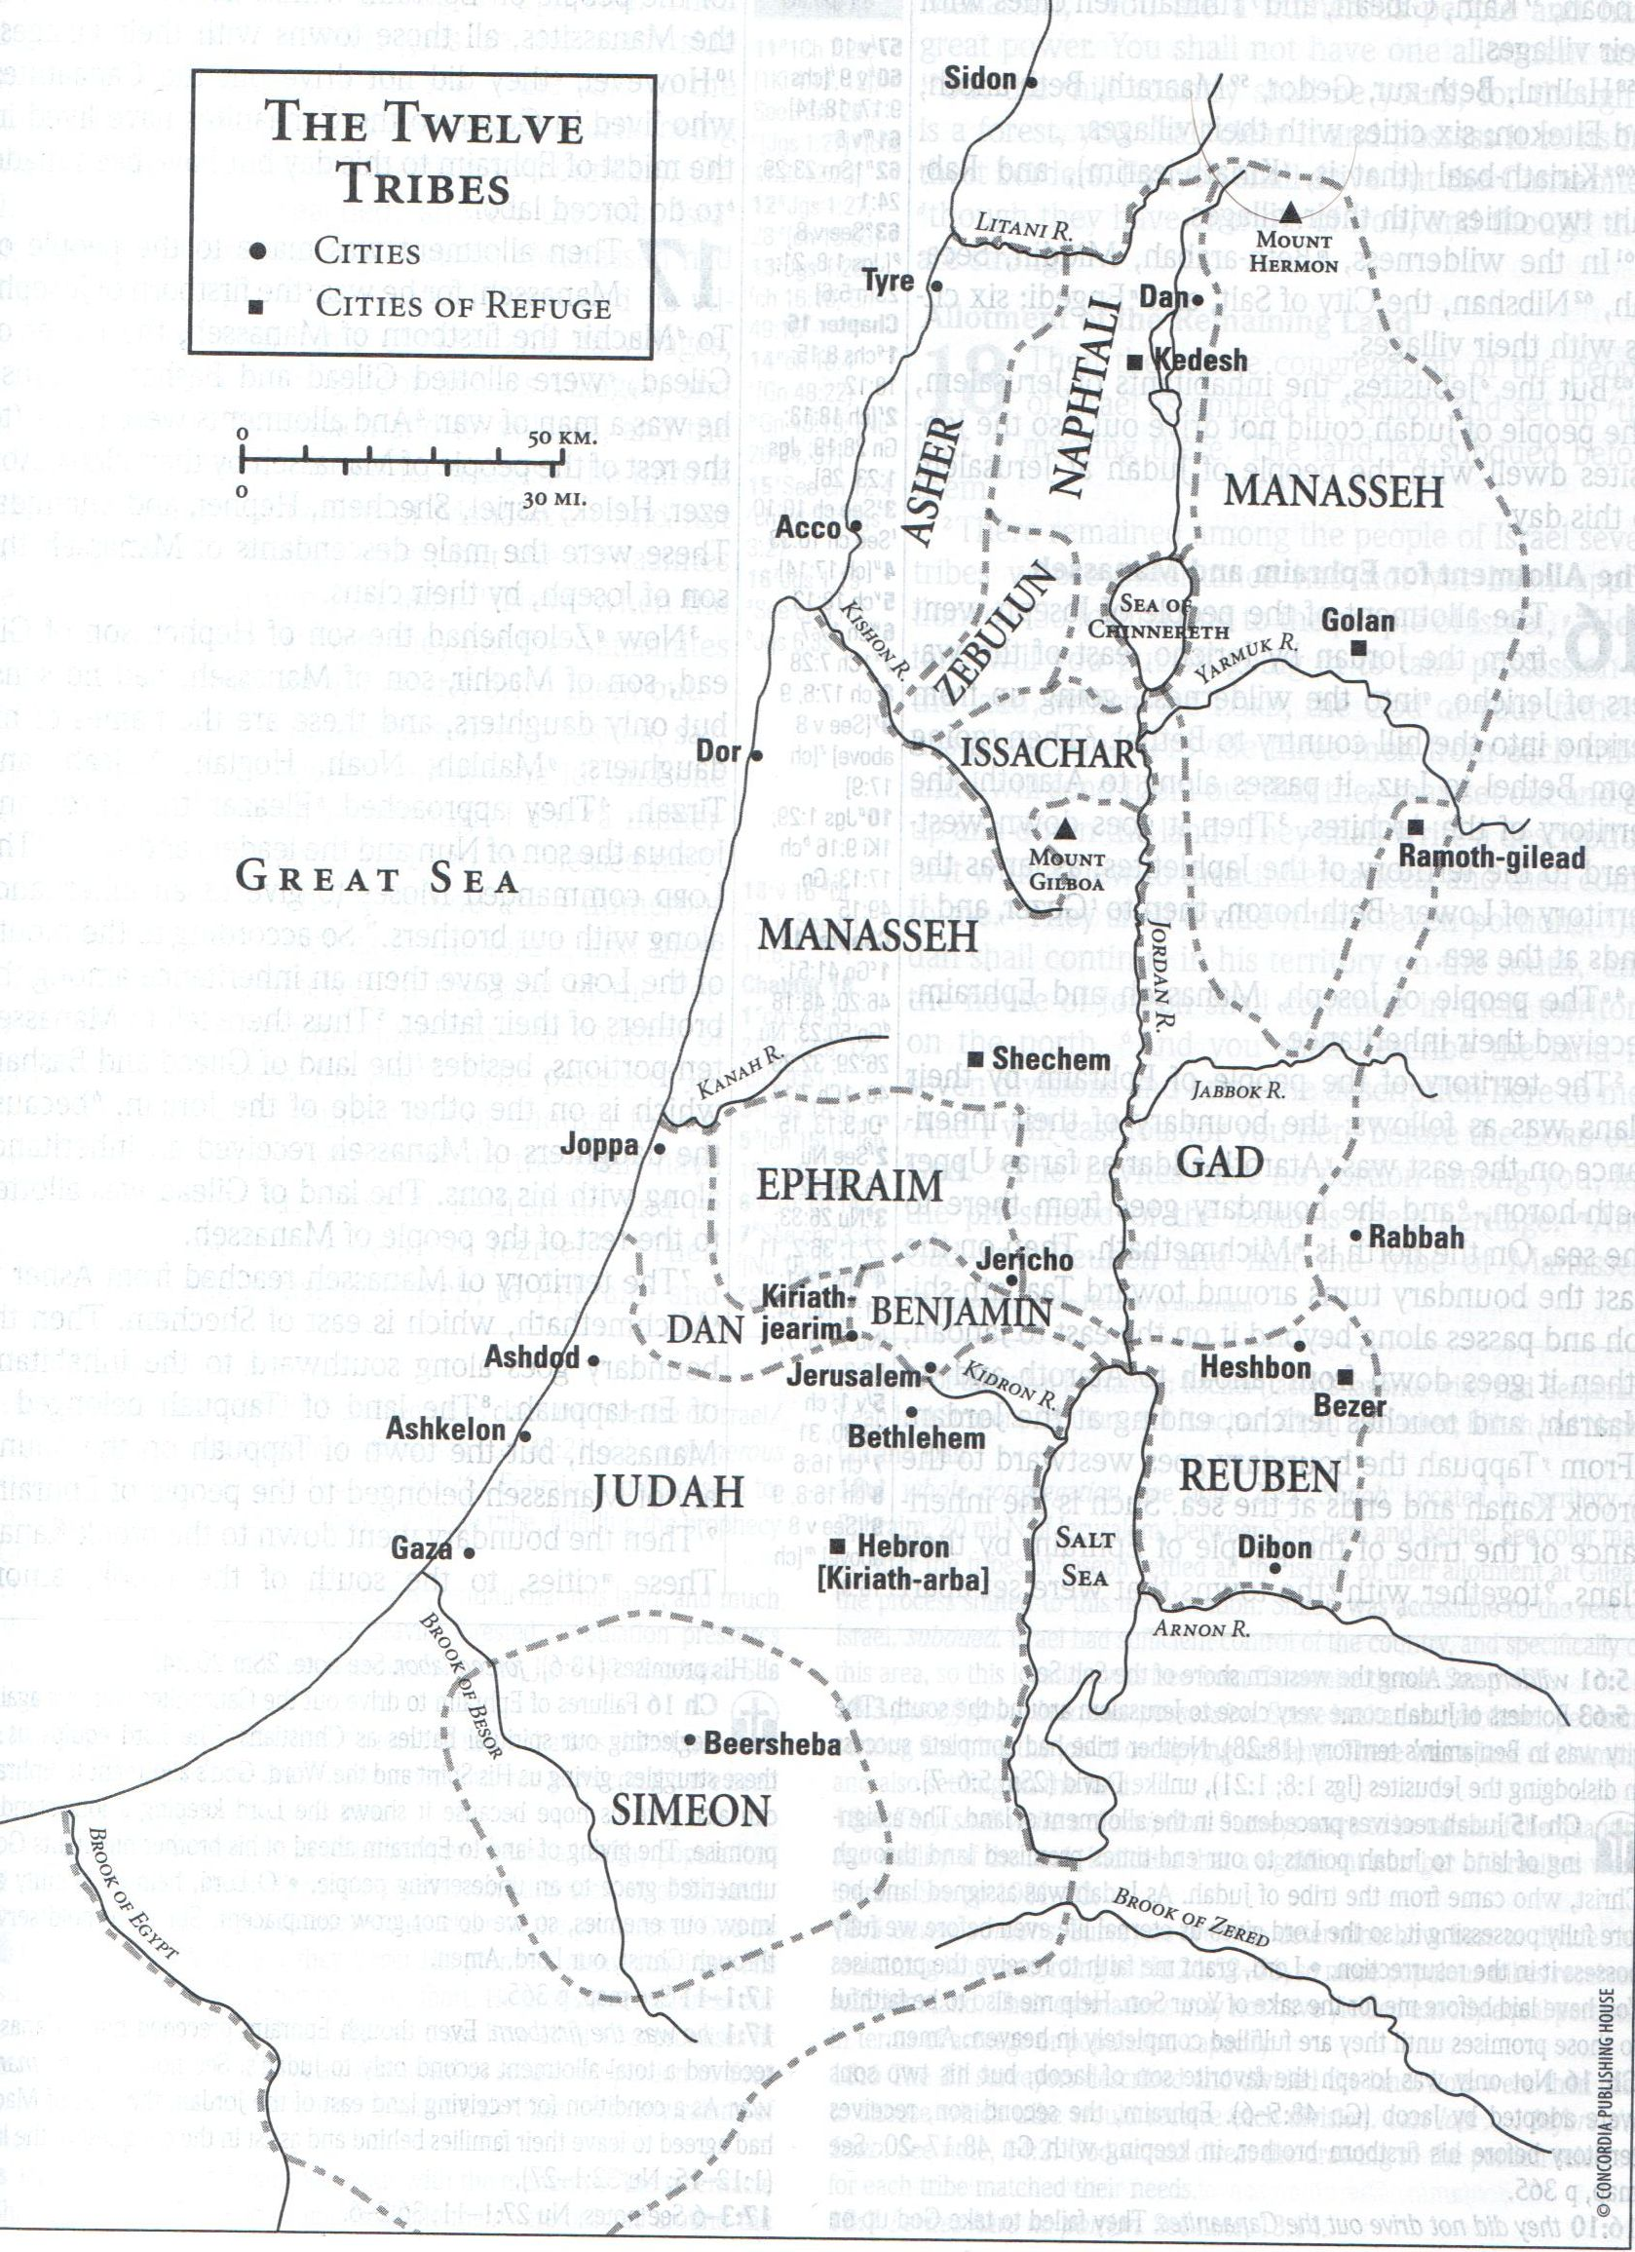

Slide 28
Chap 6: (1) "Now this is the commandment, the statutes and the rules that the Lord your God commanded me to teach you, that you may do them in the land to which you are going over, to possess it, (2) that you may fear the Lord your God, you and your son and your son's son, by keeping all his statutes and his commandments, which I command you, all the days of your life,
and that your days may be long.
(3) Hear therefore, O Israel, and be careful to do them, that it may go well with you, and that you may multiply greatly, as the Lord, the God of your fathers, has promised you, in a land flowing with milk and honey. (4) "Hear, O Israel: The Lord our God, the Lord is one. (5) You shall love the Lord your God with all your heart and with all your soul and with all your might. (6) And these words that I command you today shall be on your heart. (7) You shall teach them diligently to your children, and shall talk of them when you sit in your house, and when you walk by the way, and when you lie down, and when you rise. (8) You shall bind them as a sign on your hand, and they shall be as frontlets between your eyes. (9) You shall write them on the doorposts of your house and on your gates.

Slide 29
(10) "And when the Lord your God brings you into the land that he swore to your fathers, to Abraham, to Isaac, and to Jacob, to give you--with great and good cities that you did not build, (11) and houses full of all good things that you did not fill, and cisterns that you did not dig, and vineyards and olive trees that you did not plant--and when you eat and are full, (12) then take care lest you forget the Lord, who brought you out of the land of Egypt, out of the house of slavery.
(13) It is the Lord your God you shall fear. Him you shall serve and by his name you shall swear. (14) You shall not go after other gods, the gods of the peoples who are around you, (15) for the Lord your God in your midst is a jealous God, lest the anger of the Lord your God be kindled against you, and he destroy you from off the face of the earth.

Slide 30
(16) "You shall not put the Lord your God to the test, as you tested him at Massah. (17) You shall diligently keep the commandments of the Lord your God, and his testimonies and his statutes, which he has commanded you. (18) And you shall do what is right and good in the sight of the Lord, that it may go well with you, and that you may go in and take possession of the good land that the Lord swore to give to your fathers (19) by thrusting out all your enemies from before you, as the Lord has promised

Slide 31
(20) "When your son asks you in time to come, 'What is the meaning of the testimonies and the statutes and the rules that the Lord our God has commanded you?' (21) then you shall say to your son, 'We were Pharaoh's slaves in Egypt. And the Lord brought us out of Egypt with a mighty hand. (22) And the Lord showed signs and wonders, great and grievous, against Egypt and against Pharaoh and all his household, before our eyes. (23) And he brought us out from there, that he might bring us in and give us the land that he swore to give to our fathers. (24) And the Lord commanded us to do all these statutes, to fear the Lord our God, for our good always, that he might preserve us alive, as we are this day. (25) And it will be righteousness for us, if we are careful to do all this commandment before the Lord our God, as he has commanded us.'

Slide 32
Study Notes:
1. The “Shema” (vv. 4-9), for the Hebrew word “hear,” was the creed spoken by Jews to be recited twice daily at home, in the morning and in the evening, and every week in the synagogue. The “First Table of the Law.”
(Dt 11:13-21; Num 15:37-41;
Mt 22:37,38; Mk 12:29-31; Lk 10:27)
2. The Lord is one – a monotheistic statement against polytheist religions. This was divinely revealed.
(Jdg 2:11-13; Ps 86:10; Is 44:6; Zech 14:9;
Mk 12:29; Jn 10:30; 1 Cor 8:4; Eph 4:6; Jas 2:19)
3. Love the Lord your God – the first table of the Law
(Lev 19:18) because He has loved us (1 Jn 4:19-21)

Slide 33
4. The command (vv. 8-9) to tie these words onto your body and onto your houses is taking literally by orthodox Jews.
Small wooden boxes, called phylacteries, are stuffed with passages written on paper, and these are tied to one’s
forehead and left arm with long leather cords. Also small wooden or metal containers, called mezuzzoth, also filled
with Bible passages, are placed on the doorframes of their houses.
The figurative meaning of these passages is explained in (Dt. 11:18-20; Ex 13:9-16; Mt 23:5)

Slide 34
5. Jesus quotes (vv. 13,16) against the devil’s temptations in the wilderness (Mt 4:7-12; Lk 4:4-12)
Here we see that Jesus considered these words as the very Word of God!
6. They had tested the Lord at Massah (Ex 17:1-7)
7. In the future they were to recount all of God’s redemptive acts for Israel to their sons so that it could be passed on to the next generations. We are called to do the same, to recount all of God’s redemptive acts for the new Israel:
(Prov 1:8; Lk 1:4; Eph 6:1-4; 2 Tim 3:14-17)

Slide 35
8. Righteousness comes from God by faith and then exhibits itself in obedience
(Mt 19:17; Rom 9:31; 10:5;
Gal 5:22,23)

Slide 36
The First Commandment – Luther’s large catechism:
“You shall have no other gods.”
¹ That is, you shall regard me alone as your God. What does this mean, and how is it to be understood? What is to have a god? What is God?
² Answer: A god is that to which we look for all good and in which we find refuge in every time of need. To have a god is nothing else than to trust and believe him with our whole heart. As I have often said, the trust and faith of the heart alone make both God and an idol.
³ If your faith and trust are right, then your God is the true God. On the other hand, if your trust is false and wrong, then you have not the true God. For these two belong together, faith and God. That to which your heart clings and entrusts itself is, I say, really your God.
⁴ The purpose of this commandment, therefore, is to require true faith and confidence of the heart, and these fly straight to the one true God and cling to him alone. The meaning is: “See to it that you let me alone be your God, and never seek another.” In other words: “Whatever good thing you lack, look to me for it and seek it from me, and whenever you suffer misfortune and distress, come and cling to me. I am the one who will satisfy you and help you out of every need. Only let your heart cling to no one else…

Slide 37
⁴⁷ Let us therefore learn the first commandment well and realize that God will tolerate no presumption and no trust in any other object; he makes no greater demand of us than a hearty trust in him for all blessings. Then we shall be on the right path and walk straight ahead, using all of God’s gifts exactly as a cobbler uses his needle, awl, and thread (for work, eventually to lay them aside) or as a traveler avails himself of an inn, food, and bed (only for his temporal need). Let each person be in his station in life according to God’s order, allowing none of these good things to be his lord or idol.
⁴⁸ Let this suffice for the First Commandment. We had to explain it at length since it is the most important. For, as I said before, where the heart is right with God and this commandment is kept, fulfillment of all the others will follow of its own accord

Slide 38
Life Application:
How can we daily then endeavor to love the Lord our God
with all our heart and with all our soul and with all our might?

